Slide 1

STANDBY: Facebook field study
Presentation by Ida Dencker

Slide 2
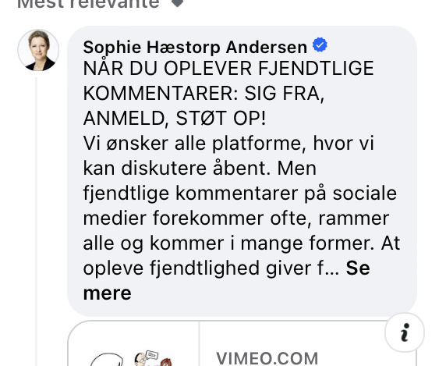
The data
Collected 1601 Facebook posts from 77 Danish local politicians
Collected over 9 weeks
27 from Århus, 50 from Copenhagen
11 politicians participated in the intervention part of the study
Instructed to post a comment encouraging people to speak up against hateful comments
51 intervention posts, 1550 control post
After cleaning the data, 13102 comments remain (489 intervention comments, 12613 control comments)

Slide 3
Questions
Main question: Is there a difference in the comments when the intervention is applied compared to when it is not?
Is there a difference across the two municipalities? Is the commenting different in Århus compared to Copenhagen?
Are there general tendencies in the commenting on the politician’s posts? Do people generally comment negatively, aggressively, encouraging etc.?

Slide 4
First step: sentiment analysis
A way of quantifying the comments (extracting attitude/sentiment/emotion)
VADER: neg, pos, neu, compound score
ROBERTA: neg, pos, neu, compound score
DANISH BERT: 9 labels e.g. tillid/accept, foragt/modvilje, glæde/sindsro
Attack: 2 labels: linguistic attack/no linguistic attack
Rec-nition: 2 labels: appreciative language/no appreciative language

Slide 5
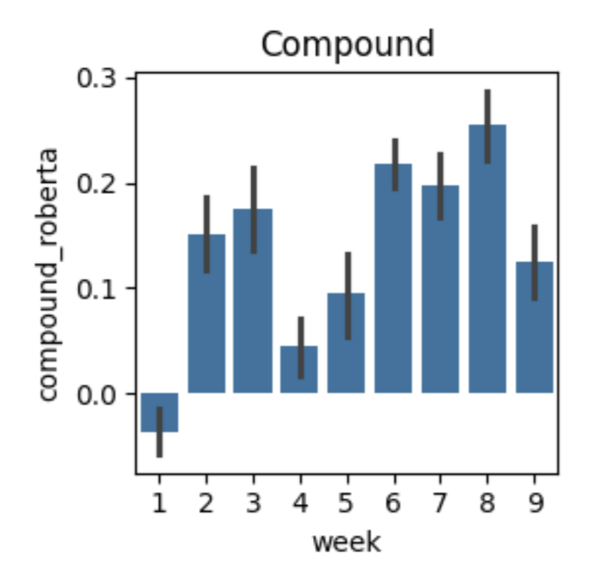
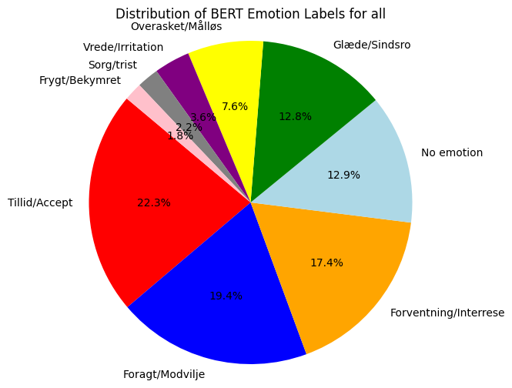
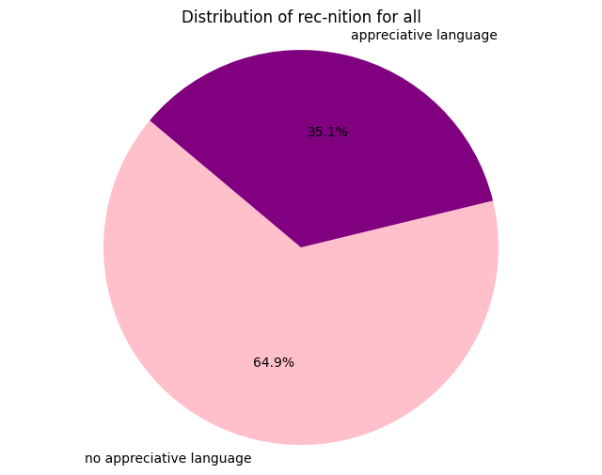
1: Visualising the sentiment scores
Mean Roberta compound score is 0,13
Neutral, leaning towards positive

Slide 6
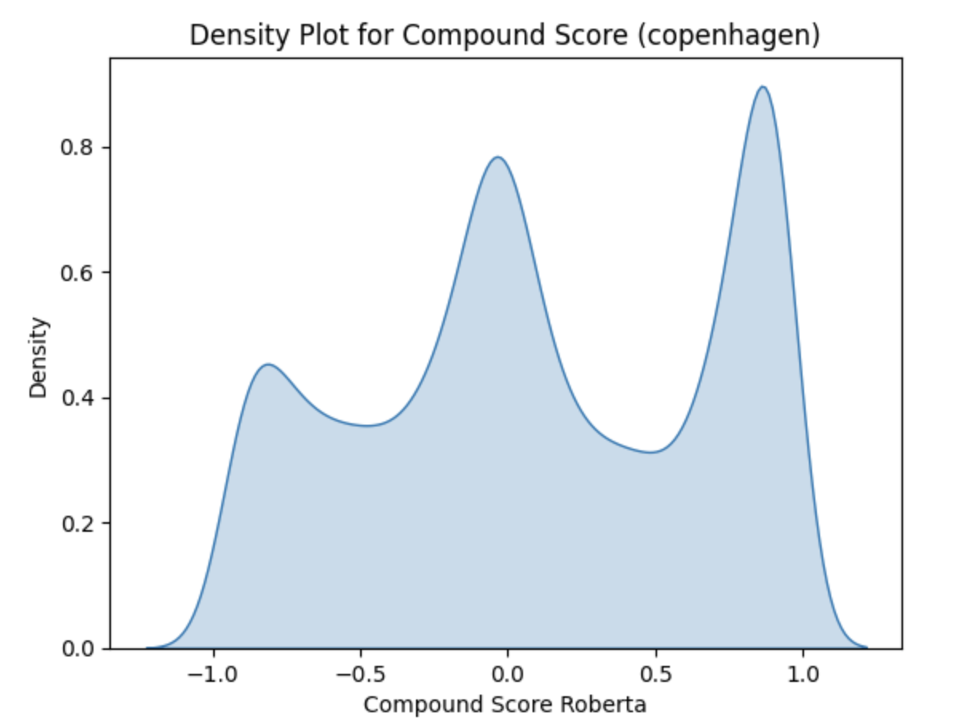
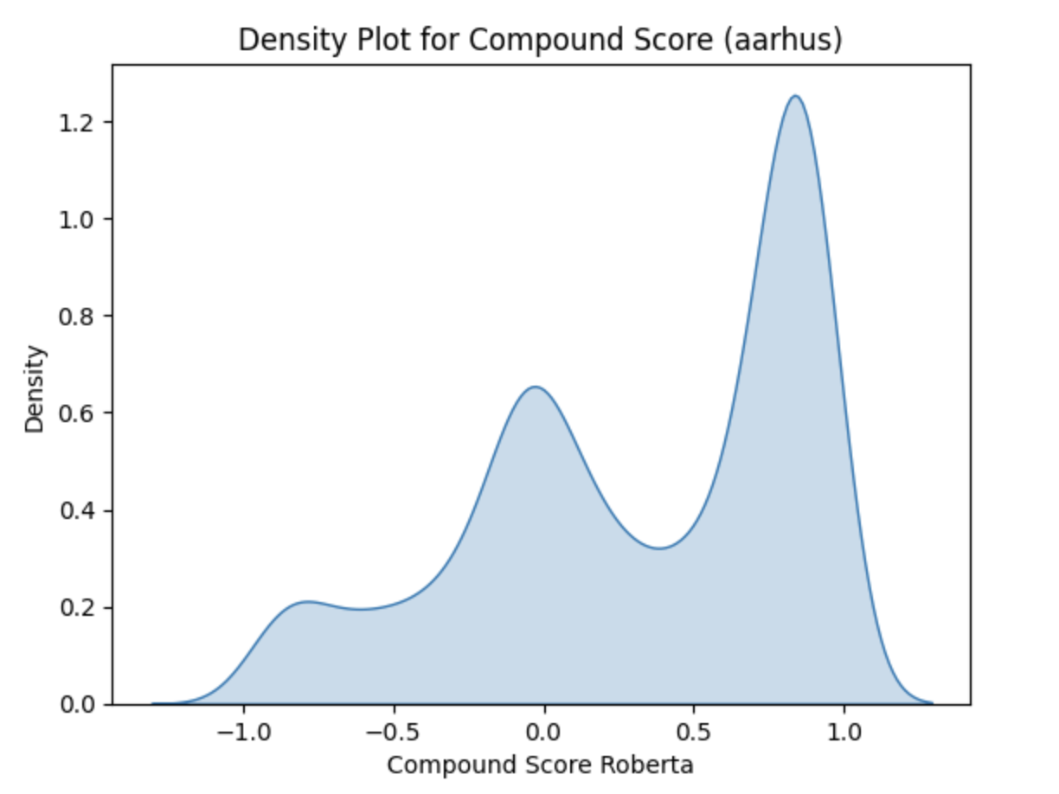
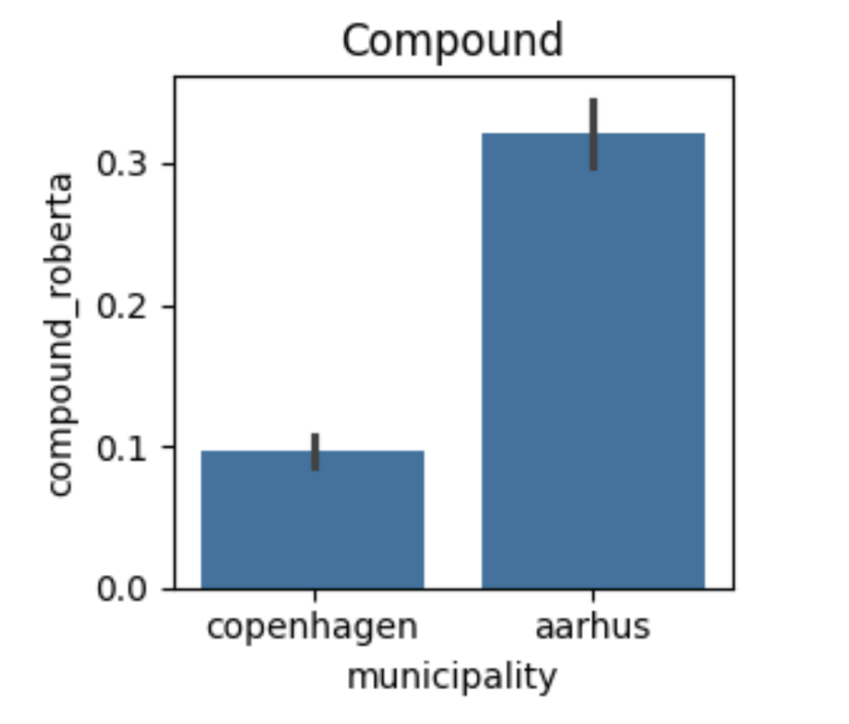
2: Differences in municipalities
Compound score ranges from -1 to +1
Conclusion: the comments from Århus are more positive than for Copenhagen

Slide 7
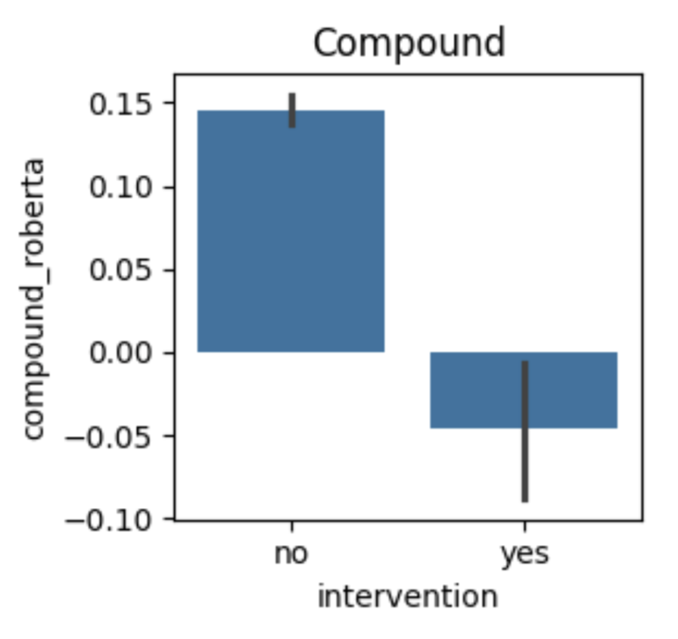
3: (Changed) sentiment in intervention?
Is there a difference in sentiment when the politician has encouraged ‘good tone’ (intervention group) compared to when they have not (control group)?
Multilevel model results: when the compound score increase with 1 (more positive sentiment) the log odds of the intervention being yes decreases: i.e. more positive sentiment entails a lower probability of the intervention being present
Conclusion: intervention did not work as intended in terms of sentiment
- Backfire effect

Slide 8
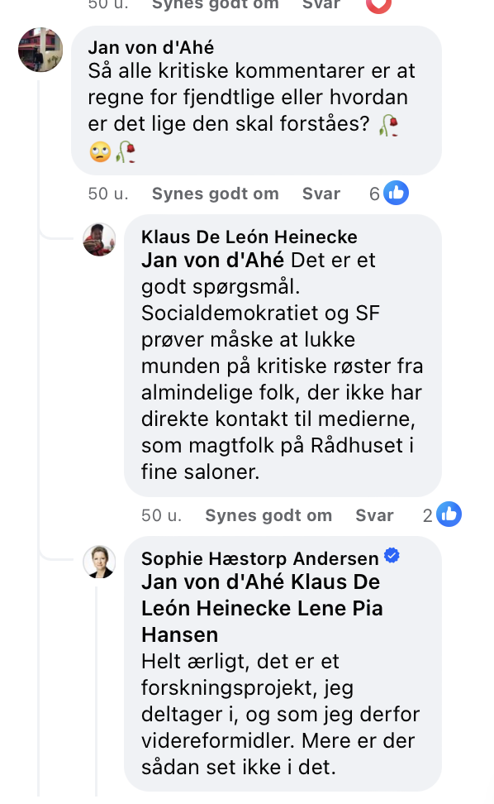
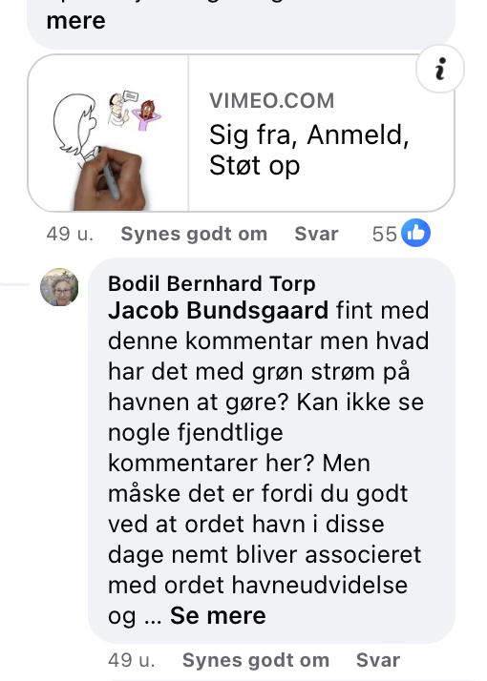
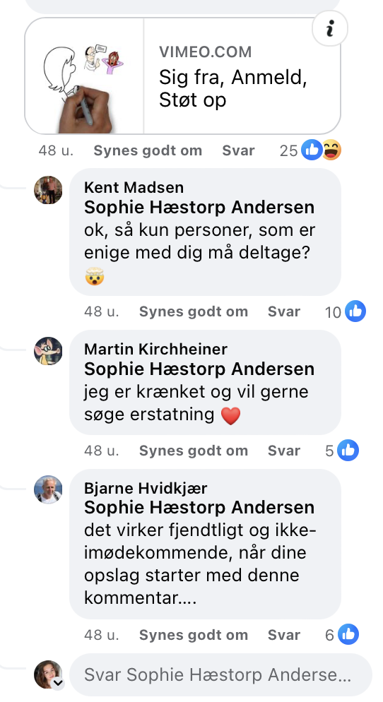
Why this backfire effect?
What type of posts are the intervention posts?
Subject like LGBT+, racism, Lynetteholmen, wokeness, municipal budgets
Possible that politicians deliberately commented the intervention on these posts
Are users triggered by the intervention itself?
Randomness: when accounting for nestedness: no sigg. Effect
Intervention data is not sufficient

